Slide 1

Mice Protein Expression Data Set
Syed Haider Saleem
Notes:
Hi, my name is Syed Haide Saleem. Today I will be taking you through a very interesting data science problem. We will try to follow the datascience steps and solve this problem

Slide 2
Dataset and Problem
Mice Protein Expression Data Set
Taken from UCI Machine Learning Repository
77 proteins with a total of 1080 measurements per protein (Input Features)
Environment features like Genotype, Behaviour, Treatment
Genotype: control (c) or trisomy (t)
Treatment type: memantine (m) or saline (s)
Behavior: context-shock (CS) or shock-context (SC)
Classification Problem
Notes:
Right, so I choose project 3 for my assignment as it posed a very interesting scenario of classifying the mice dataset. The dataset was taken from UCI Machine Learning Repository. It contains a total of 1080 measurements per protein which came from a total of 72 mice. Each mouse was kept in a different environment which is classified as Genotype, Treatment or Behaviour. After keeping them in different environments what we are interesting in seeing is how each protein expresses in different conditions

Slide 3
Goal
The aim is to identify subsets of proteins that are discriminant between the classes.
Notes:
The goal of this project is to identify subsets of protiens that are discriminat between the classes meaning that we are looking for those protiens based on which we can easily classify that if a mouse has a expression level range of this to that then this mouse could belong to this particular category. So our task is classification in nature

Slide 4
Data Preparation
Data Retrieving
Load Data
Inspect Data
Handling Missing values
Outliers
Notes:
Like with every dataset we also need to treat this dataset in a specific way and apply few basic produces to make it ready to feed to our model. We know that data preparation roughly takes about 80% of the whole data science process and is definitly the most important stage.
This data was available in a xls file format so first we had to convert it into csv and then load it using corresponding pandas function. We then inspect the data by looking at its records and number of features. The mosy important part was to deal with the missing value as our data did contain alot of missing values and we simply cannot drop them as it will greatly reduce our data; hence what we did was to fill in the missing values with the mean of that particular column class wise. Our data also contained alot of outliers but I decided not to change them as it could represent a real life case and we do assume that these measurements were taken carefully by the experts.

Slide 5
Exploration
Exploring Each Column
Exploring relationships between columns
Notes:
The came the exploration part which is mandatory to know more about your data
We tried to explore each column sepeartly as well as collectively

Slide 6
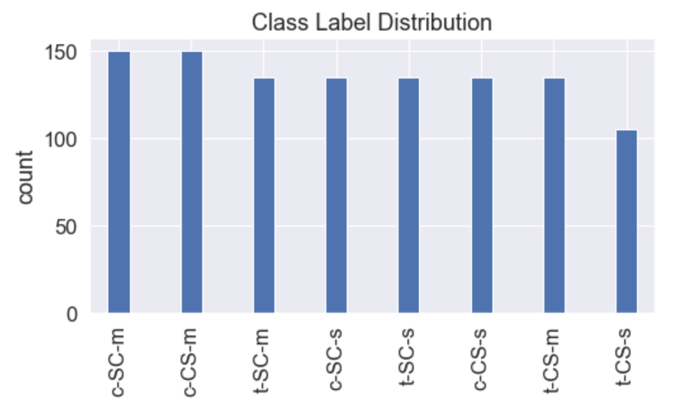
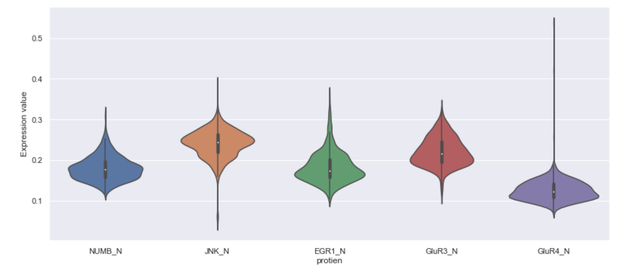
Exploring each column (Takeaways)
Exploration is done using Bar charts, violin plots, correlation metrics and scatter plots
Takeaways
Distribution of each class is almost the same
Each protein has a different expression
Notes:
Some of the take aways from individual exploration were that representaion of each class was almost same and we realised that each protein expressed different which we can see from the voilin plots in the picture below

Slide 7
Pairwise relationships
Hypothesis: Is there any relationship between each protein
Correlation metrics shows some relation but mostly No relation
Hypothesis : does expression level of protein depends on environment attributes (Genotype, Treatment or behaviour independently)
No they does not
Hypothesis : Does each mouse responds differently to same protein
Yes each mouse responds to same protein differently
Notes:
Some key hypothesis that we tested were to find out if there were any relation between each protien which we figured from correlation metrics and find out that it does exits in few cases but mostly there was no relation
Another hypothesis was that does expression level depends on environments attributes indivually but we saw that indivudual impact of these conditions is not that significant, combination of these condiitons does have an impact
And in the last hypothesis we found out that each mouse responds differentluy to even the same protien

Slide 8
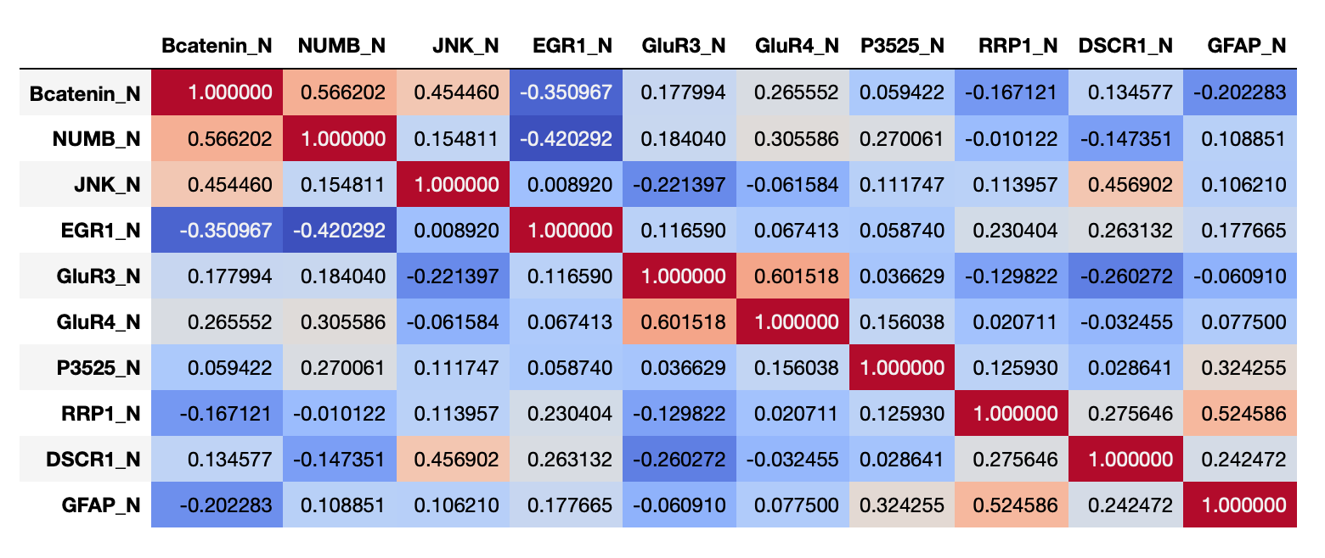
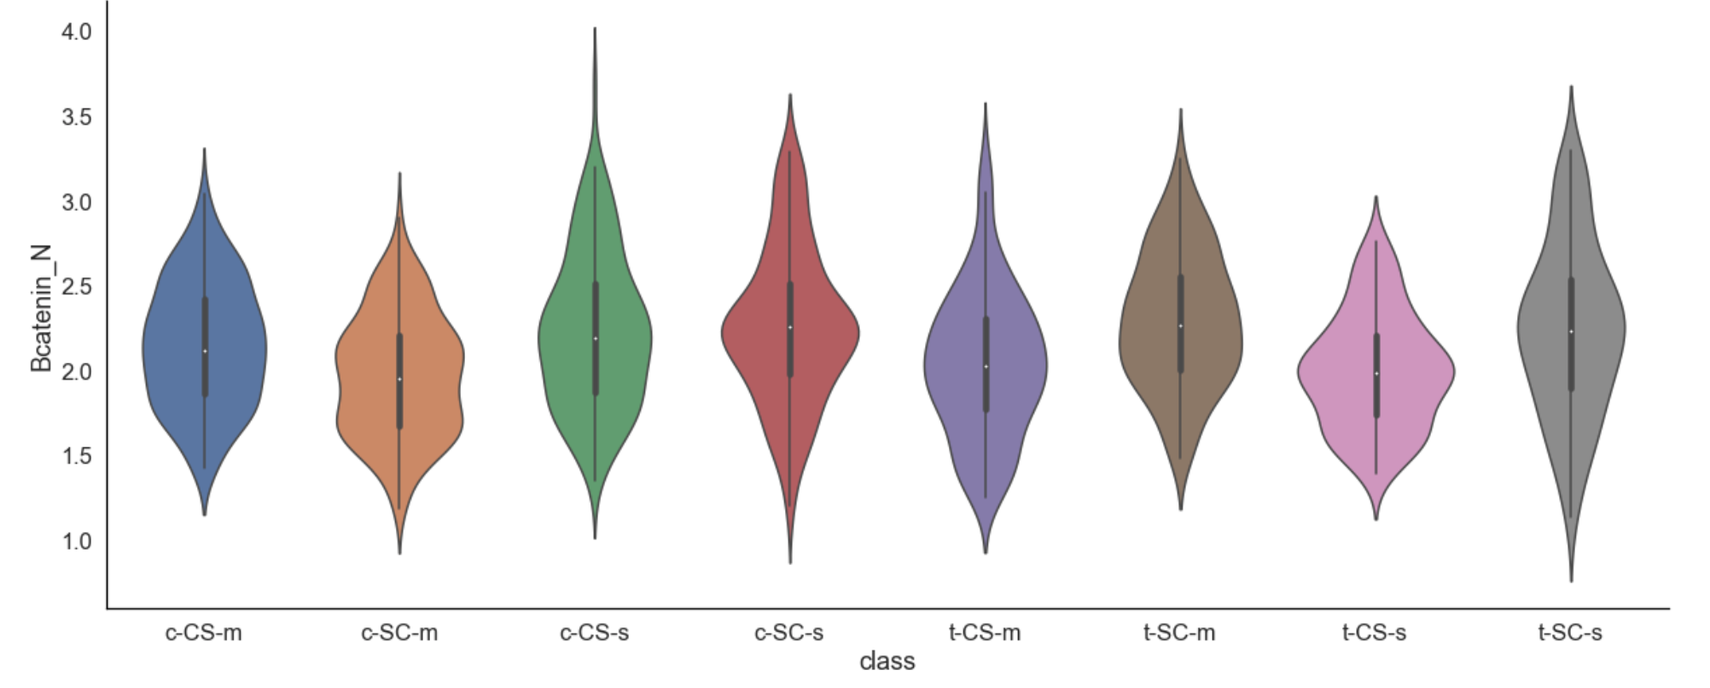
Notes:
These graphs supports my claim for the hypothesis mentioned in the previous slides

Slide 9
Data Modeling
K Nearest neighbors
Feature selection using hill climbing
Scaling and Normalizing
Finding the best K
Train Test split (80%, 20%)
Model fitting (training)
Prediction
Decision Trees
Feature selection using hill climbing
Train Test split (80%, 20%)
Model fitting (training)
Prediction
Parameter Tuning using Grid Search with cross validation
Notes:
Then comes the important part of data modeling on which our assignment learning objective was based. We choose two machine learning models for the modeling part which were KNN and decision trees bith have their strengths and weaknesses. For each model some of the preprocessing steps were same as features selection suing hill climbing algorithm, test train split but some preprocessing steps were specific to each algorithm as knn requires us to normalize the data as it calculate the distances, also the hyperparameters are different. The test train split was taken as 80% training to 20% testing in each case. And then model was trainned and predicted using the evaluation metrics defined which was accuracy in our case along with F1 score. We also used grid search to optimize parameters icnase of decison trees

Slide 10
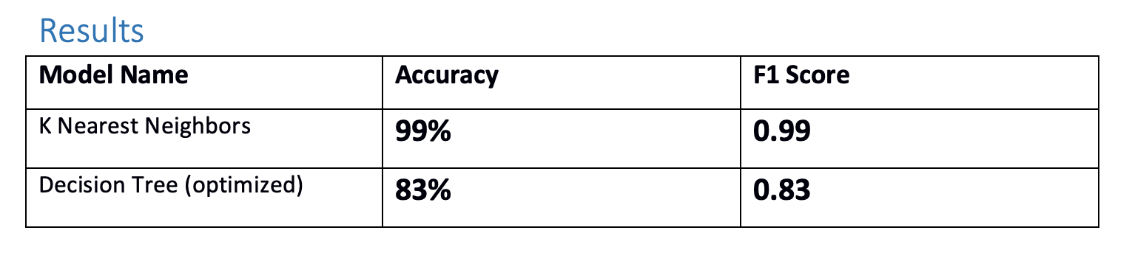
Results
Notes:
KNN clearly outperformed decision tree with an accuracy of 99% to an accuray of 83% for the decison tree

Slide 11
Conclusion and Discussion
KNN outperformed Decision Tree by an accuracy of 99% to 83%
Decision Tree more robust to noise, computationally less efficient
KNN require more preprocessing and computation cost
For this dataset we will still use KNN for classification
Random Forest can be tried in the future
Notes:
Now based on results we can pick KNN as a clear winner. Eventhoug there are other factors to consider like robustness to noise and comoutation efficeintly in which decision tree has an edge but considering the problem and small size of dataset we will use KNN in our real life setting fro this problem. FOr future the modeling can be extrended to random forest but for now we are happy with knn

